Slide 1
POC Plan
Feb 11, 2015

Slide 2
OPSW ENV Setup [done]
Appliance up and running
Enroll new server
Create Audit job and script java

Slide 3
Type0: Base
UC01: get server info
UC02: run script job
UC03: run compliance job
Web Service API
Raw Message
pyTwist
Java
CLI
OPSW

Slide 4
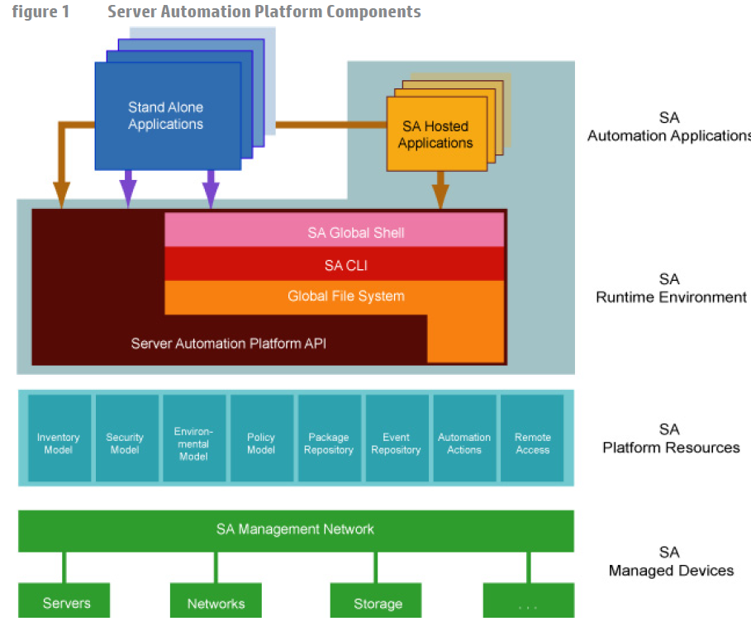

Slide 5
Clients
SA Command-Line Interface (CLI): Launched from Global Shell sessions, shell scripts can access the SA Platform API by invoking the CLI methods, which are executable programs in the OGFS. Each CLI method corresponds to a method in the API.
Web Services: Using SOAP over HTTPS, these clients send requests to SA and get responses back. The Web Services operations (defined in WSDLs) correspond to the methods in the API. Developers can write Web Services clients in popular languages such as Perl and C#.
Java RMI: These clients invoke remote Java objects from other Java virtual machines.
Pytwist: These Python programs can run on an SA Core or managed servers.

Slide 6
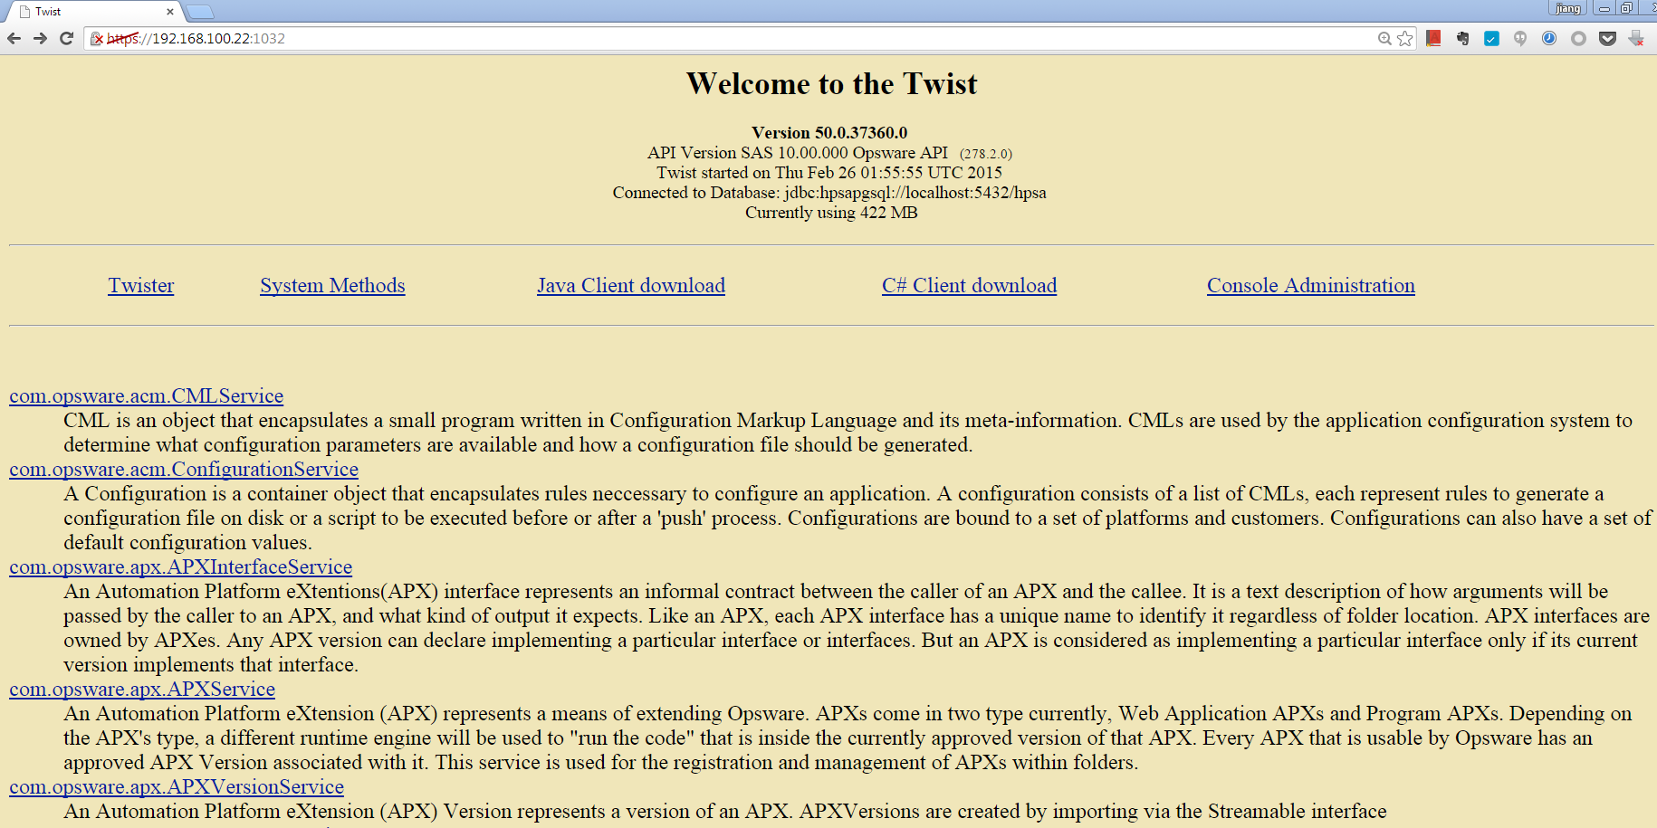
twister
https://cic:1032/

Slide 7
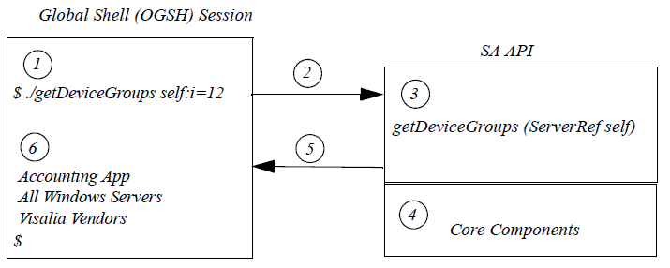
CLI: base
ssh session to OGFS
ls /opsw/Server/@/[servername]/method
ls /opsw/api

Slide 8
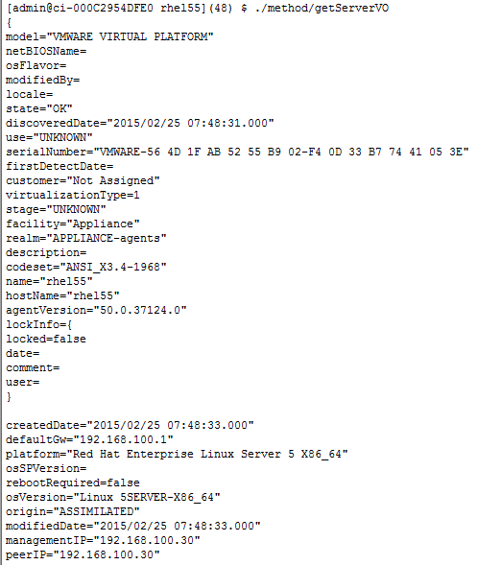
CLI:UC01:get server info
cd /opsw/Server/@/rhel55
./method/getServerVO
Output:

Slide 9
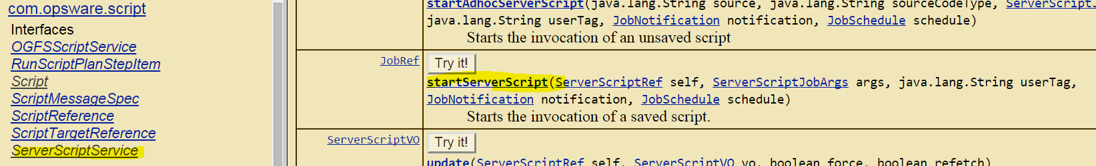
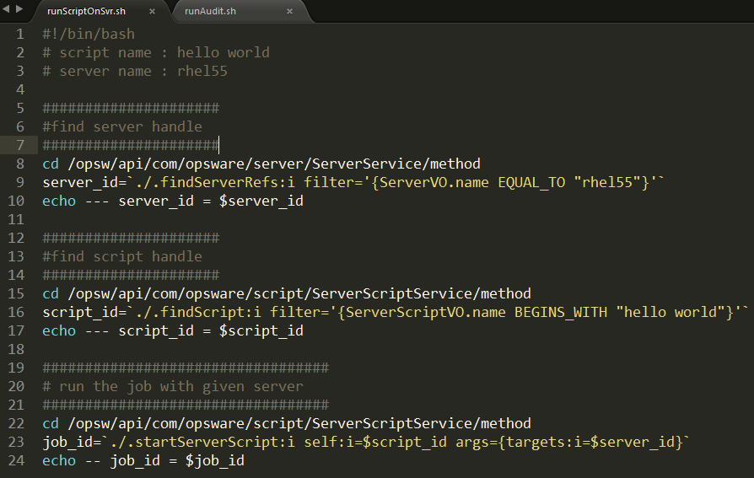
CLI: UC02:run script job

Slide 10
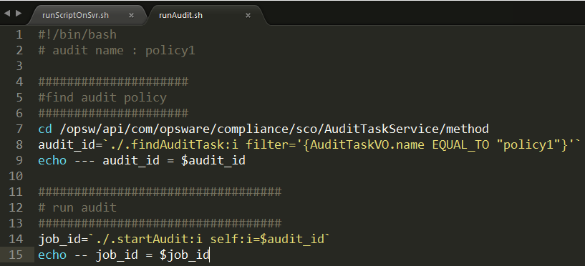
CLI: UC03:run audit job
https://192.168.100.22:1032/twister/docs/com/opsware/compliance/sco/AuditTaskService.html

Slide 11
Pytwist:base
Can only be run in managed server or core server
Python class → java class mapping

Slide 12
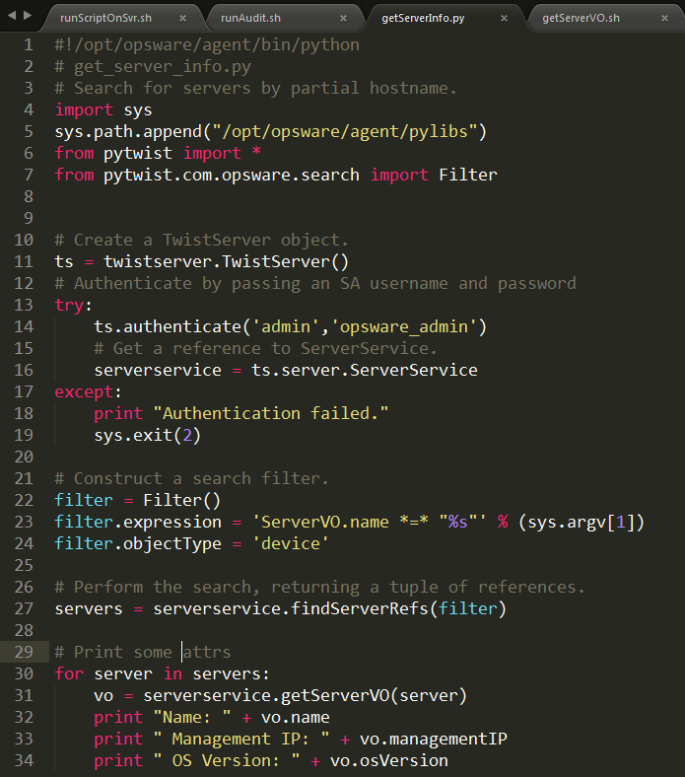

Pytwist:UC01:getServerInfo

Slide 13
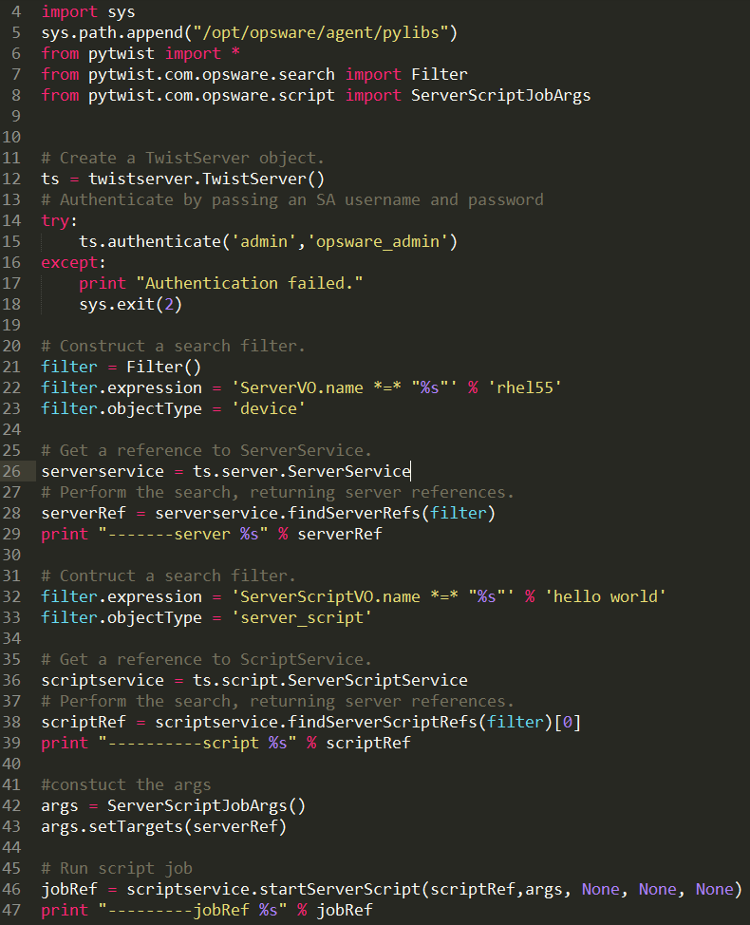

Pytwist:UC02:run script against server

Slide 14
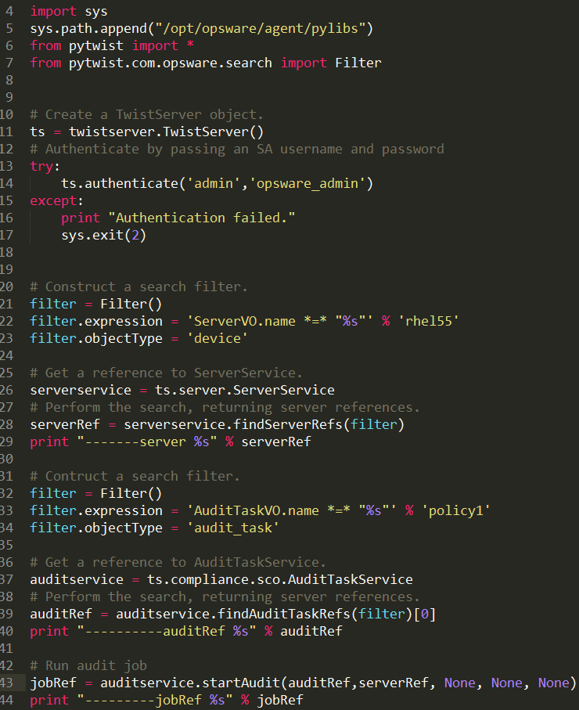
Pytwist:UC03:runAuditJob

Slide 15
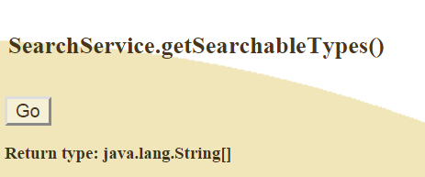
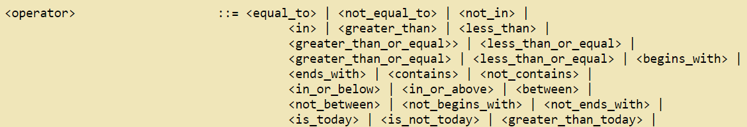
Side note: filter
https://192.168.100.22:1032/twister/docs/com/opsware/search/SearchService.html

Slide 16

JavaRMI:base
Libs:
JavaDoc:
https://owc:1032/twister/docs/index.html

Slide 17
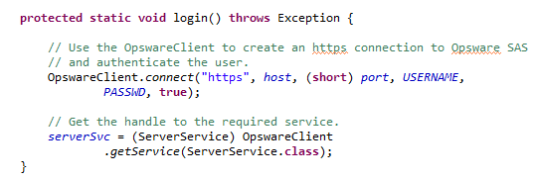

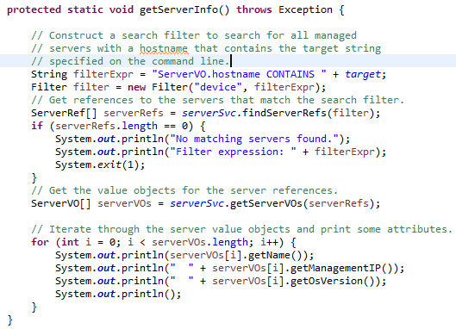
JavaRMI:UC01:getServerInfo

Slide 18

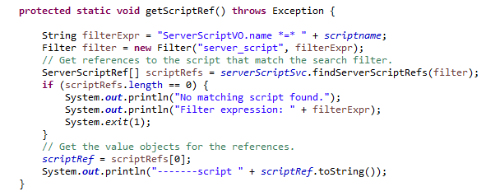
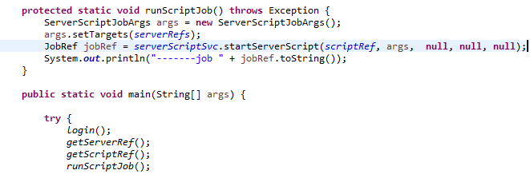
JavaRMI:UC02:runScriptJob

Slide 19
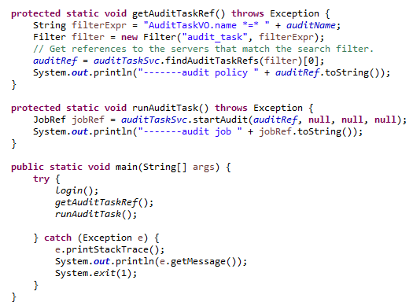

JavaRMI:UC03:runAuditJob

Slide 20
Tier 1: REST/ Javascipt UI
JavaScipt as End to End Task execution
UC01: get server info
UC02: run script job and get result
UC03: run compliance job and get result
REST server
Web Service API
Raw Message
pyTwist Script
JavaRMI
OPSW

Slide 21
REST interface
Function | URI | Response
Get one server | /server?name=rhel55 | ServerVO
Get all servers | /servers | ServerVO[]
Run audit job | /auditjob?name=policy1 | JobVO
Run script job [TBD] | /scriptjob?server=rhel55&script=hello%20world | JobVO
Get job result | /job?ref=100021 | JobVO
https://github.com/mt5225/opswJSON

Slide 22
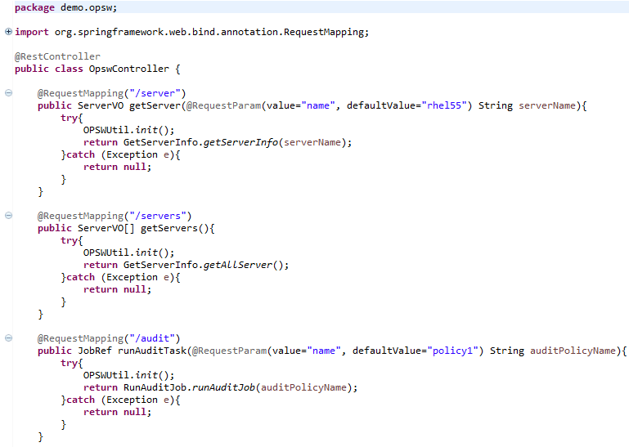
REST: controller

Slide 23
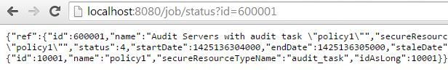
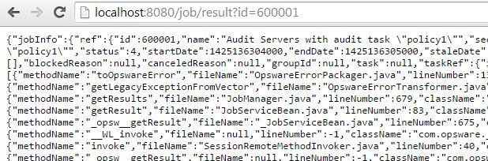
REST: request and results

Slide 24
Tier 2: lightweight task manager[LTM]
JavaScipt as End to End Task execution
UC01: get server info
UC02: run script job and get result
UC03: run compliance job and get result
LTM
Web Service API
Raw Message
pyTwist Script
Java
OPSW

Slide 25

Tier 3: Orchestration
UC01: TBD
Web Service API
Raw Message
pyTwist Script
Java
OPSW

